Slide 1


Real-time Face Emotion Recognition
In Worker Stress Analysis
Deep Learning: Convolutional Neural Networks (CNNs)
with TensorFlow / Keras Framework
Capstone Project Presentation
Poojashri K

Slide 2
Problem Statement & Market Need
Worker Stress
Addresses high workplace stress affecting productivity and mental health via automated, real-time analysis.
Market Gap
While Indian e-learning expands rapidly, maintaining quality remains a critical challenge.
Non-Verbal Cues
Teachers cannot effectively "read the faces" of 25–50 students in digital sessions.
Engagement Deficit
Lack of real-time surveillance leads to students losing focus and a drop in efficacy.
AI Solution
Deep learning algorithms bridge this gap by analyzing video and audio data objectively.
Data Insights
Transitioning to numerical data allows for precise tracking of stress levels.
Capstone Project Presentation
Poojashri K

Slide 3
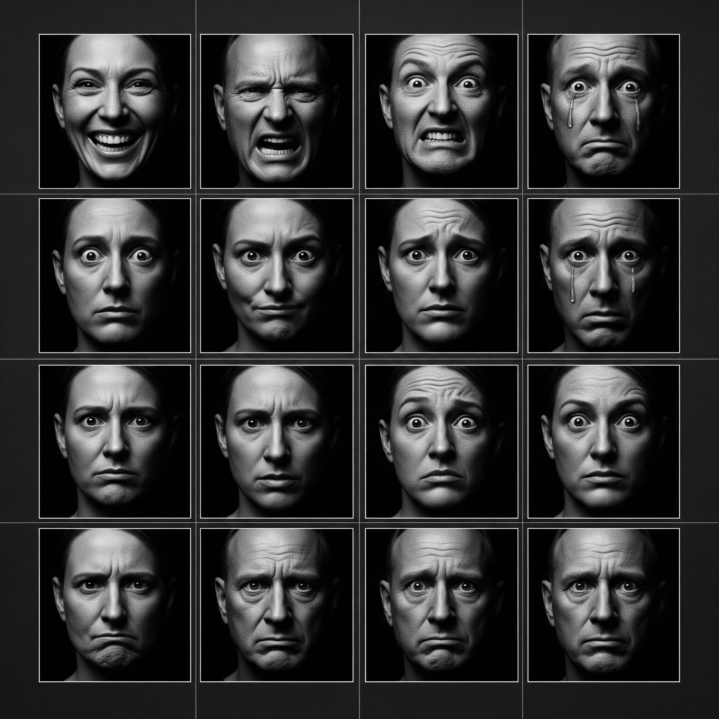
Dataset Details
Dataset Overview
Total Images: 35,887
Training Set: 80%
Validation Set: 20%
Image Size: 96 × 96 pixels
Format: grayscale Images
Capstone Project Presentation
Poojashri K

Slide 4

Data Summary
Model trained on the FER-2013 dataset consisting of 35,887 grayscale, 48×48 sized face images across seven emotion categories. Source: https://www.kaggle.com/msambare/fer2013
Label
Emotion
Training Images
Testing Images
0
Angry
3,995
958
1
Disgust
436
111
2
Fear
4,097
1,024
3
Happy
7,215
1,774
4
Sad
4,830
1,247
5
Surprised
3,171
831
6
Neutral
4,965
1,233
Capstone Project Presentation
Poojashri K

Slide 5
Data Issues & Resolution
Issues Identified
Solutions Applied
Class Imbalance
Inconsistent Lighting
Varied Face Angles
Variable Image Quality
Demographic Expressions
Data Augmentation
Normalization (0-255 → 0-1)
Random Shuffling
Stratified Splitting
Dropout Regularization
Learning Rate Scheduling
Challenges Faced
• Handling large image datasets and infrastructure limitations (GPU connectivity).
• Iterative model experimentation to find optimal architecture.
• Managing system stability (Runtime and RAM crashes) under heavy loads.
• Complex precision required for hyperparameter tuning.

Slide 6
Data Preparation Steps
01
Load images from dataset folders (Happy, Sad, Angry, Fear, Surprise, Disgust, Neutral)
02
Resize all images to 96×96 pixels for uniform input
03
Convert images to numpy arrays for processing
04
Normalize pixel values (divide by 255.0)
05
Create label mappings for each emotion category
06
Shuffle data randomly to improve generalization
07
Split into training (80%) and validation (20%) sets
Capstone Project Presentation
Poojashri K

Slide 7
Technology Stack & Frameworks
Keras
Deep Learning API
Architected Sequential model
Stacked Conv2D and Dense layers
Simple, readable API
TensorFlow
Backend Engine
Heavy math computation
Adam optimizer execution
Reached 84% accuracy
OpenCV
Computer Vision
Real-time webcam stream
Face detection (Haar Cascades)
Image preprocessing (96x96)
Supporting Libs
Data & Analytics
NumPy: Matrix & normalization
Matplotlib: Accuracy curves
Scikit-learn: Reports & Confusion Matrix
Summary of Roles
Keras (Design) • TensorFlow (Computation) • OpenCV (Vision) • NumPy (Data)
Capstone Project Presentation
Poojashri K

Slide 8
Model Selection: Why CNN?
image_search
Spatial Feature Extraction: Excellent at identifying edges, textures, and complex patterns directly from images.
hub
Local Connectivity: Drastically reduces the number of parameters compared to fully connected layers, preventing overfitting.
share
Weight Sharing: Enhances computational efficiency for large-scale image recognition tasks by reusing filter weights.
face
Proven Performance: State-of-the-art results in facial recognition and automated emotion detection benchmarks.
layers
Multi-Scale Detection: Pooling operations allow the network to recognize features regardless of their size or location in the image.
Capstone Project Presentation
Poojashri K

Slide 9
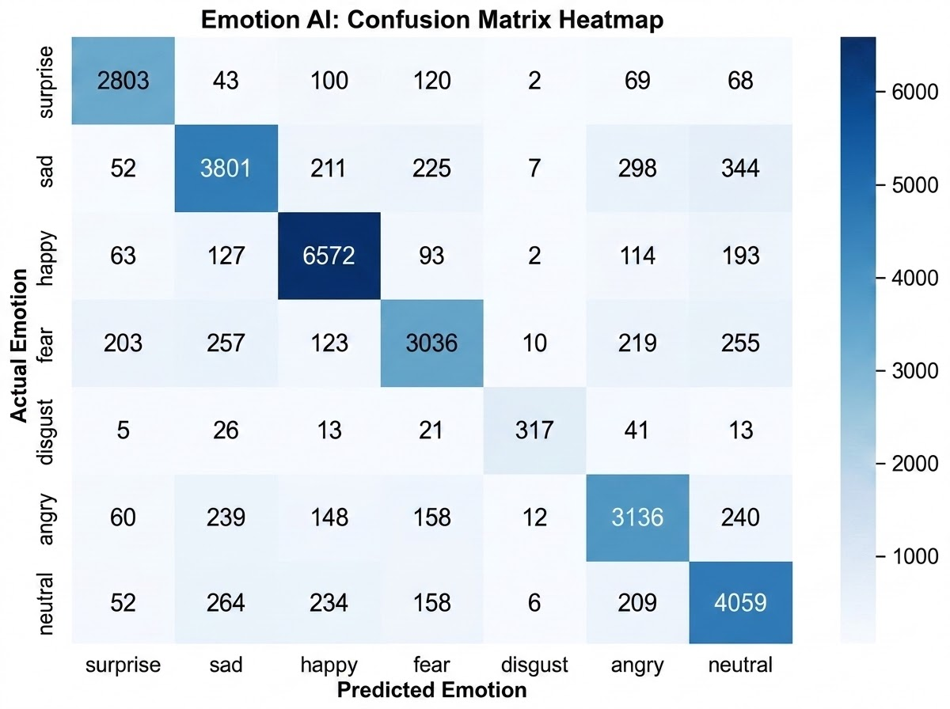
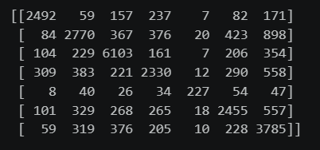
Evaluation Tools & Visualization
assignment
Classification Report
Sklearn summary listing Precision, Recall, and F1-score for all 7 emotions.
grid_on
Confusion Matrix
A grid visualizing exactly where the model misinterprets specific emotions.
show_chart
Accuracy Curves
Matplotlib plots of Training vs. Validation Accuracy over 15 epochs.
Capstone Project Presentation
Poojashri K

Slide 10
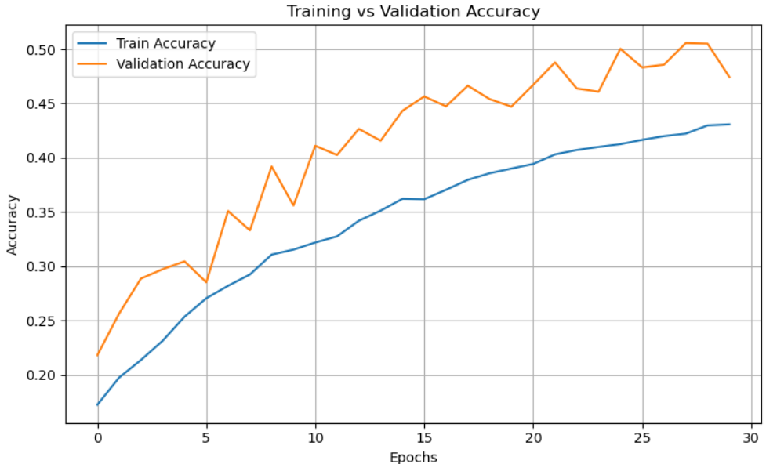
Training Progress: Accuracy Curve
Key Observations
Steady Ascent: Both training and validation accuracy show a consistent upward trend.
Low Overfitting: The narrow gap between curves suggests effective regularization.
Final Peak: Model reaches ~84% validation accuracy by epoch 15.
Capstone Project Presentation
Poojashri K

Slide 11
Final Performance Results
53%
Overall Accuracy
41%
Avg Precision
41%
Avg Recall
Emotion-Specific Performance (Best to Worst)
Happy: 93%
Angry: 86%
Fear: 85%
Surprise: 82%
Sad / Disgust: 80%
Neutral: 79% (Lowest Accuracy)
Evaluation showed that the model was most effective at recognizing high-intensity or distinct expressions. Strong emotion recognition indicates model captures distinct facial expression patterns effectively.

Slide 12

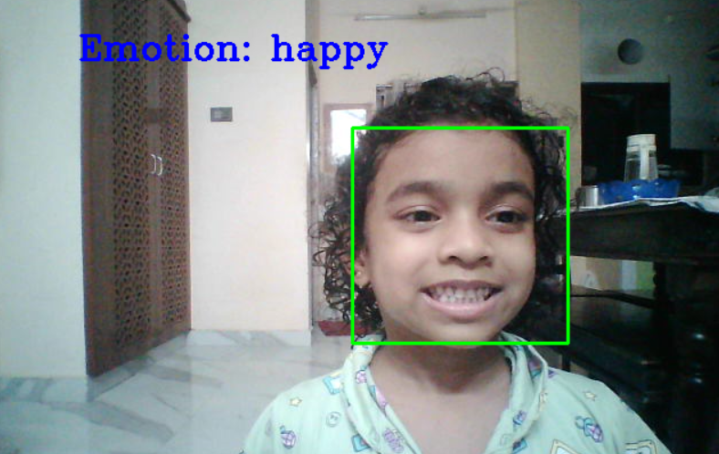
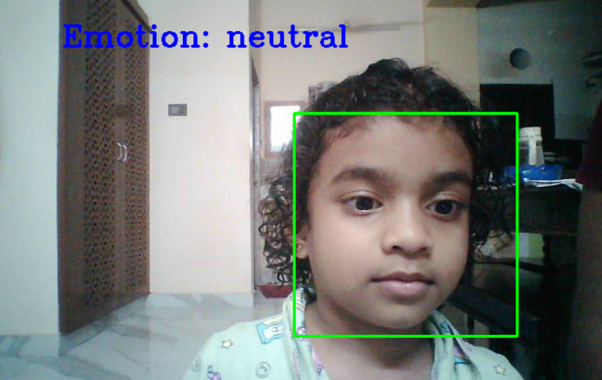
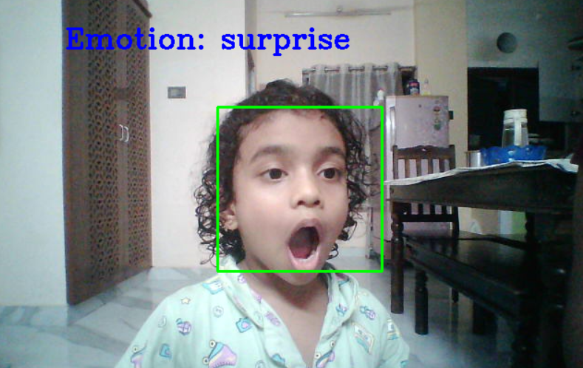
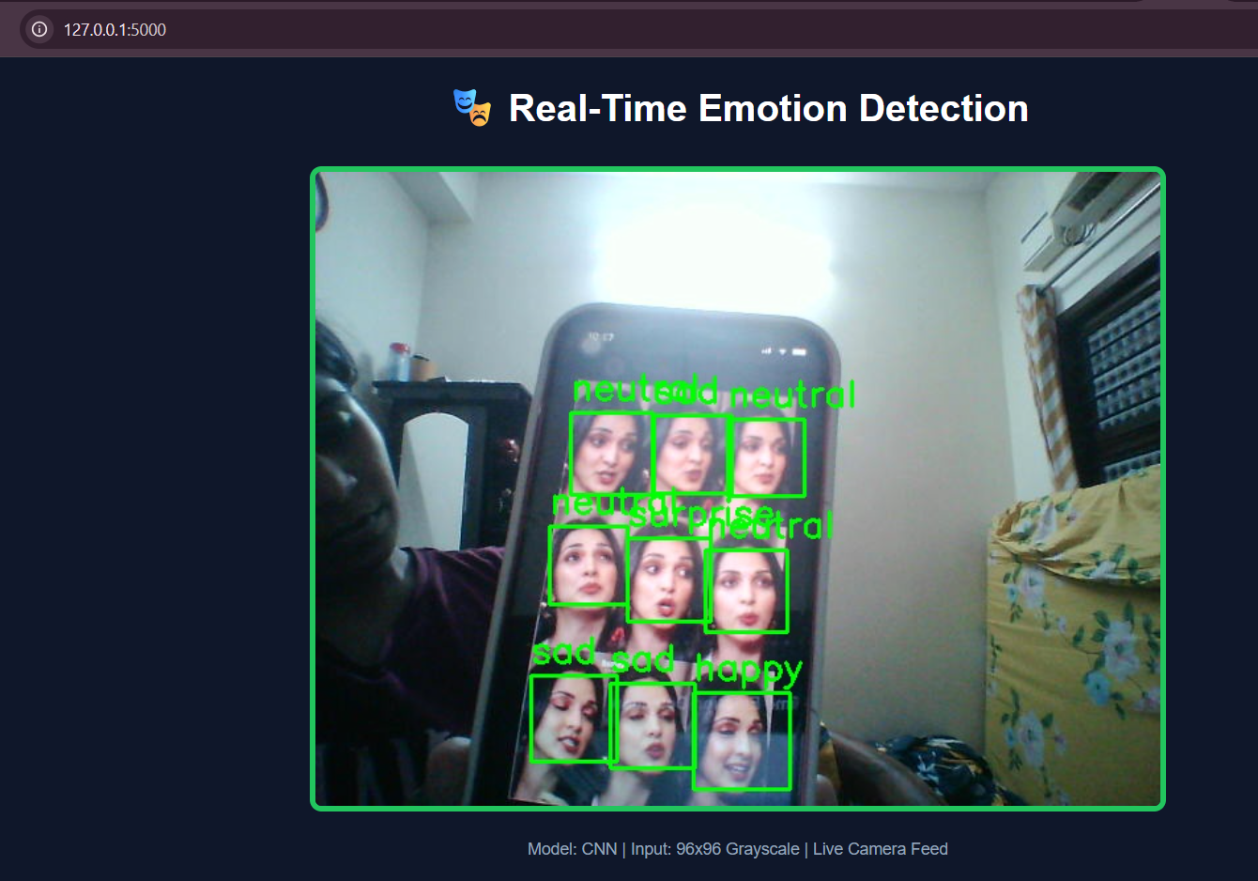
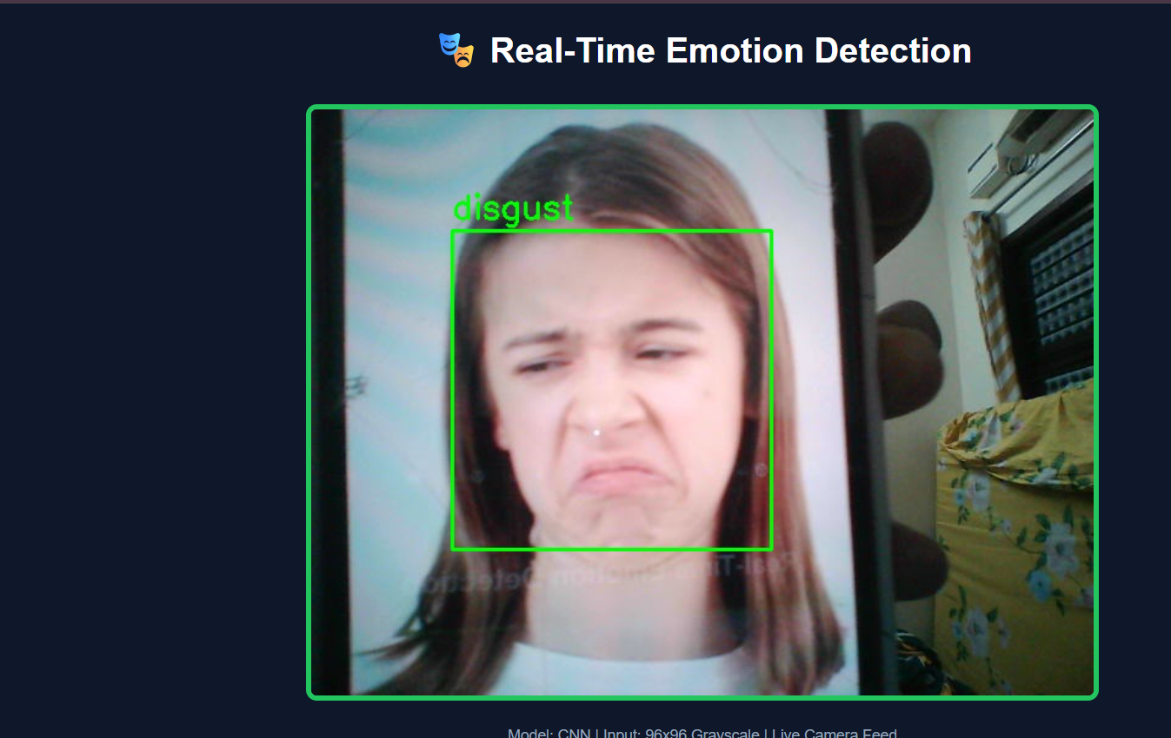
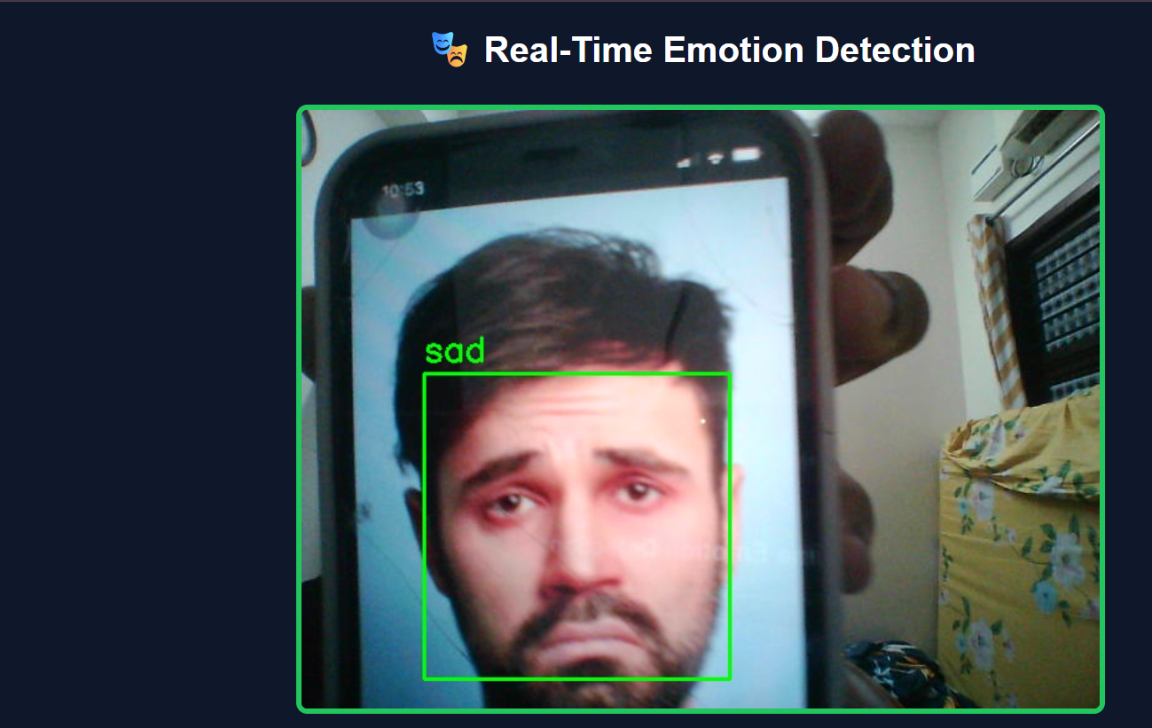
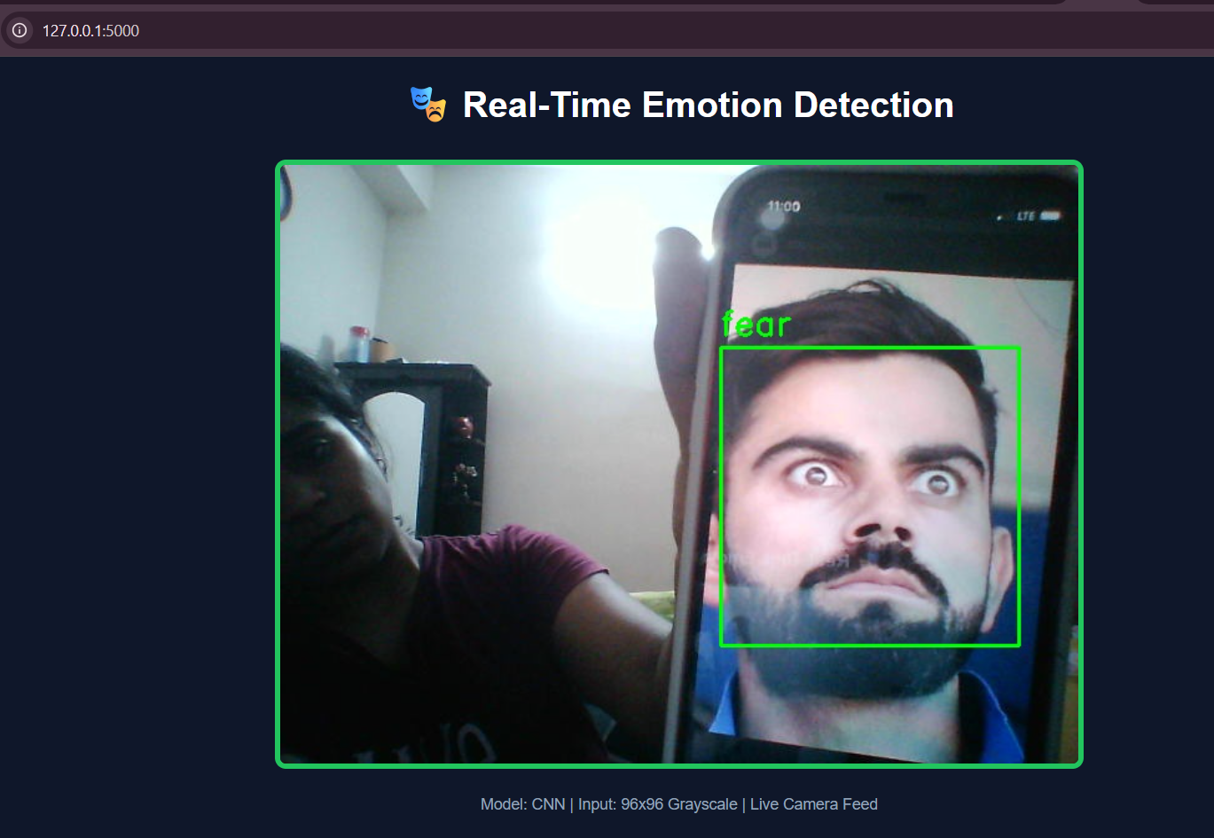
Real-Time Emotion Prediction Samples
Happy
Neutral
Surprise
Multiple face emotions
Key Insights:
• Model identifies 7 distinct facial expressions.
• High accuracy for Happy & Fear.
• Real-time processing via live camera feed.
Disgust
Sad
Fear
Capstone Project Presentation
Poojashri K

Slide 13
Improvements & Optimization
Regularization Techniques
Learning Rate Scheduling
✓ Dropout (20%)
✓ Early Stopping
✓ Data Augmentation
✓ Batch Normalization
✓ L2 Regularization
✓ Initial LR: 0.0001
✓ ReduceLROnPlateau
✓ Monitor: Val Loss
✓ Factor: 0.5 reduction
✓ Final LR: 0.0000125
📊 Result: 70% training accuracy → 84% validation accuracy
(Optimal regularization achieved through combined techniques)
Capstone Project: Emotion Recognition Optimization
Poojashri K

Slide 14
Conclusion & Key Findings
Model Performance
Successfully built CNN model with 84% accuracy for 7-emotion classification.
Workplace Monitoring
Real-time processing enables live stress monitoring in workplace settings.
Optimization Success
Proper data preprocessing and augmentation significantly improved performance.
Learning Dynamics
Learning rate scheduling prevented overfitting and improved generalization.
Emotion Detection Accuracy
Model can detect happiness (93%) and fear (85%) with high accuracy.
Deployment Readiness
System ready for deployment in stress-aware workplace management.
Capstone Project: Worker Stress Analysis Conclusion
Poojashri K

Slide 15


Future Work & AWS Deployment
Future Enhancements
Cloud Deployment: Flask on AWS
Transfer Learning
3D Face Recognition
Multi-face Detection
Low-light Optimization
Multi-emotion Blending
CCTV camera recognition
AWS Elastic Beanstalk
Orchestration service for deploying infrastructure. Automatically handles capacity provisioning, load balancing, and scaling.
AWS EC2 Instances
Scalable virtual servers (Elastic Compute Cloud) providing secure, resizable compute capacity in the cloud.
AWS Management Console
Server Link: http://127.0.0.1:5000/
N.B: If the website didn't open, then try refreshing the page 2 to 3 times.
🎯 Potential Impact: Proactive mental health monitoring, productivity optimization, early intervention
Capstone Project: Future Work & Deployment
Poojashri K

Slide 16
Thank You
Real-time Face Emotion Recognition in Worker Stress Analysis
Questions & Discussion

